Slide 1
Whamcloud and Quality
Lustre User Group
Austin TX
April 2012
Chris Gearing & Mike Stok
  Software Engineers
  Whamcloud, Inc
Version 1.0

Slide 2
Agenda
Whamcloud’s View Of Quality
A Year’s Progress
The Year Ahead
Maloo ‘Your Window onto Test’ – Mike Stok

Slide 3
Whamcloud’s View Of Quality

Slide 4
Whamcloud’s View Of Quality
The only thing I’m non-Linear about is Whamcloud not delivering what it says it will deliver ”
Eric Barton
CTO Whamcloud

Slide 5
Whamcloud’s View Of Quality
Whamcloud’s view of quality development
Features Performance
Stability
Quality
Time

Slide 6
Whamcloud’s View Of Quality
Whamcloud is investing money, time and expertise in Quality
…is continuing to develop tools and invest in infrastructure to enhance the Lustre community
The whole of its engineering team is orientated around quality principles

Slide 7
A Year’s Progress

Slide 8
Landing Test Performance
For landing testing we have carried out;
  687 days of landing testing
  2381 landing sessions
  2092758 individual tests
  2087607 passed
Statistically
  1425 passes
  956 failures
  59.85% Session passed

Slide 9
Landing Test Performance
This chart shows the percentage of landings that passed all tests since LUG 2011

Slide 10





Distributed Test
Source code repository
ISVs
Public
Sector
Resellers

Slide 11





Distributed Test
But!
Source code repository
ISVs
Public
Sector
Public
Sector
Resellers
Resellers

Slide 12
Juelich Supercomputer Centre
Juelich financed a fully equipped cluster
Used for testing all head releases
Specialises in failover testing
  36TB of multi attached storage
Good for performance regression tests
  Private network with no contention so results are repeatable
Also used for manual large Lun testing for 2.2 release
I’d like to thank Juelich and in particular Frank Heckes for making this happen

Slide 13
Indiana University
Indiana provided a 36 node cluster for the development and rollout of a backup test system
Used for secondary 2.2 release testing
Enabled the transfer of the primary test cluster from the West Coast to Colorado without any break in the Lustre test and landing processes
Again I’d like to thank Indiana and Steve Simms for enabling this

Slide 14
The Year Ahead

Slide 15
Development vs. Landing Test
Which is landing test?
Which is development test?

Slide 16
Development vs. Landing Test
Distinct paths for development vs. landing
  Similar process but distinct purpose
Provide for maximum flexibility in development testing
  Encourage systematic test to be part of the development process
  Test during development does improve product quality
Encourage peer review as the code is written
  Earlier review leads to better code and more opportunity for education
Be auditable
  Improvement requires knowledge of the past
  Development test part of the landing collateral
100% pass rate for landing test
  Developers should push tried and tested code for landing

Slide 17







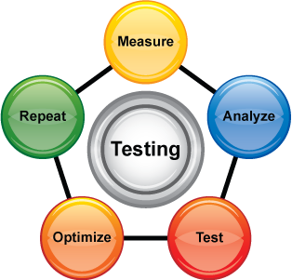

Development Test Cloud

Slide 18
The Goal

Slide 19
Summary
Whamcloud’s Quality Approach
A Review Of The Last Year
Our Plans For The Coming Year

Slide 20
Maloo ‘Your Window onto Test’
Notes:
I'm going to give a quick overview of Maloo for the next few minutes.
I've been with Whamcloud for a little over six months now, and most of my time has been spent on Maloo.
The purpose of Maloo is to give you a window into our test system. While Maloo is centred around the results from autotest it does offer visibility into some other parts of the test system.

Slide 21
Maloo Agenda
What is Maloo?
Recent changes to Maloo
  High points since last LUG
Development priorities
  Tool quality
  Easy access to timely, accurate data
Some planned features
  User preferences
  Automated scanning of incoming log files for “interesting” data
Notes:
Here's my agenda for this talk about Maloo:
First I'll give a high level view of what Maloo is.
Then I'll talk about some of the changes which have been made to Maloo since last LUG, time is short so it's just a sample of the high points.
Then I'll talk about the development priorities which the quality of Maloo itself, and the quality of the service it provides to its users - hopefully giving them easy access to data which is timely and accurate.
Then I'll talk about some of the features planned for Maloo, again it'll be a couple of interesting examples as there are lots of improvements in my ticket list! These might be superseded by other features, and the two I'll describe today are scanning incoming log files for "interesting" content and providing prominent navigation to the interesting parts of the logs, and user preferences.
Finally, time permitting we'll answer questions or take feedback.

Slide 22
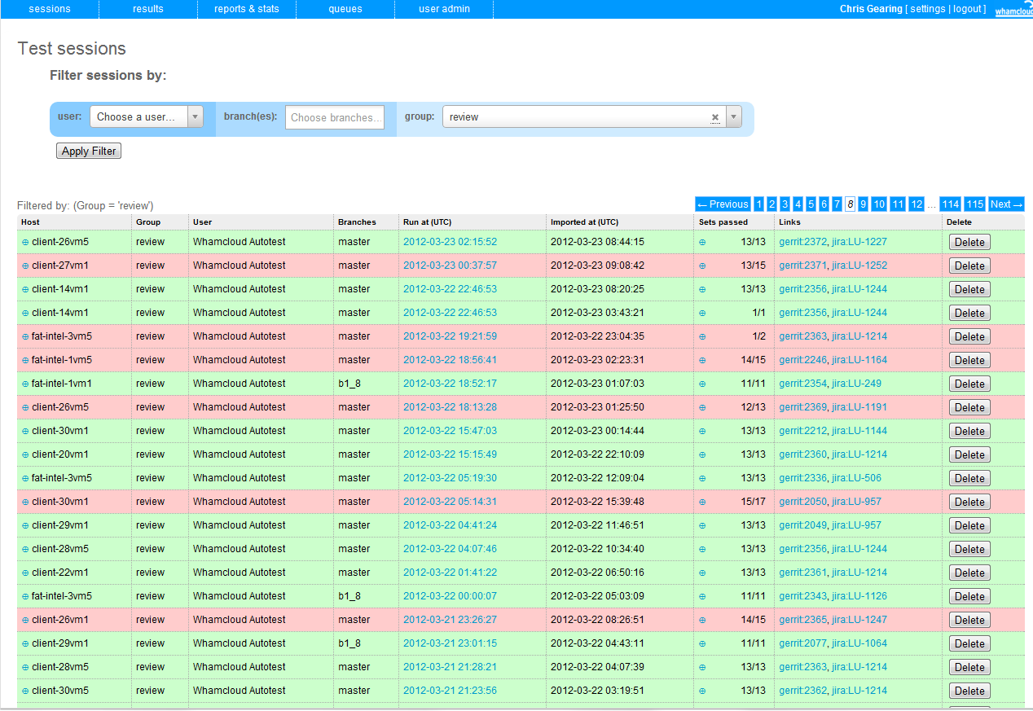
What is Maloo?
A repository for lustre test result data
  Collects the test results and the logs generated
  Allows users to query the database
  Contains about 1TB of log files
https://maloo.whamcloud.com
Notes:
So, what is Maloo?
Maloo is a web application for collecting results and log files from auster and making those results and log files available. The biggest input to Maloo is our autotest system. Developers and testers can upload their own results files using the web interface or a shell script they can download.
There are two components to the data we store, the "digested" results which are in YAML files describing the tests run and the nodes they were run on, and the console output and test log files from the node provisioning and test runs.
We store the log files from the tests and system provisioning to have a record of how both Lustre and the test system provisioning are working. By preserving the logs we can do retrospective investigations.
Maloo lets users search the results and download log files from past runs.
So Maloo is a result storage and search system, it's publicly accessible on the web at maloo.whamcloud.com - there is a sign up.

Slide 23
Recent changes to Maloo
Notes:
Now I'll move on to a couple of the prettier recent changes to Maloo, there have been lots of changes under the covers and there are lots of changes on my to-do list.
The reports I'll show make use of the data in Maloo from the test results and help us get a sense of how the testing is going in terms of Lustre quality and in terms of how well we're using, um, utilizing the test resources.

Slide 24
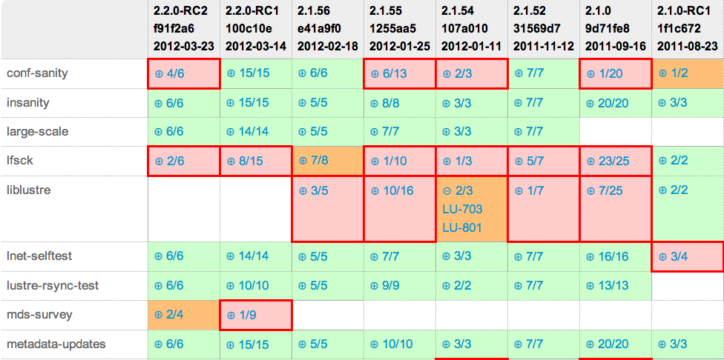
Release report
https://maloo.whamcloud.com/reports
Notes:
This is a section of the release report. Looking at the column headers we see git tags, some of the SHA1 for the revision, and the date the commit was made - the most recent commit is at the left. The rows are the test sets, alphabetically ordered.
As we prepare a Lustre release this report combines test data in Maloo and revision data from the Git repository to allow the release manager to see if the release's quality is improving, and to drill down to the test results or Jira issues quickly.
The tool finds all the results for runs involving a particular revision and determines how many of the test sets passed and failed.
The green cells indicate that all the tests passed, the red cells are where there is a higher proportion of failed tests than in the previous run (things are getting worse), and the amber cells are where the proportion of failures is smaller than the previous revision, but there are still failures.
This report lets the release manager quickly get a sense of how a release is shaping up, and eliminates the manual task of keeping the data in a spreadsheet.

Slide 25
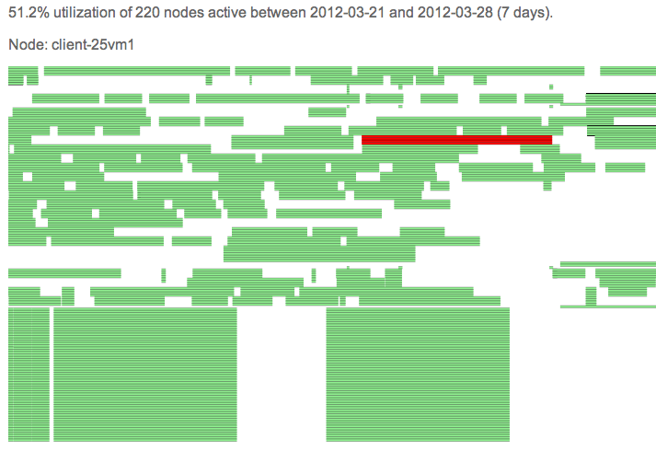
Node utilization report
https://maloo.whamcloud.com/reports/show_node_utilization_report
Notes:
This is a relatively new report which we are using to get a better idea of how effectively we're using our test clusters. Time runs from left to right across the display, and each row represents a node (they're sorted alphabetically at the moment, and that currently works well for grouping them together). Periods of time when there are Maloo test results for a node participating in a test are green, and the white gaps are "idle time". We have yet to integrate with the node reservation software (SLURM) so some of that white space could be accounted for because a developer is using some nodes for development.
When the mouse is over a node then it and the other nodes participating in the test set run are highlighted red, and if you want to you can drill down to the test results.
Looking at this you can see that there are two distinct sets of nodes. At the top is Whamcloud's Toro cluster where we typically use four nodes per test, and at the bottom you can see nodes in the LLNL Hyperion cluster where a test session can involve hundreds of nodes.
There are several improvements slated for this, but once you know how to read this it already conveys a lot of information at a glance.

Slide 26
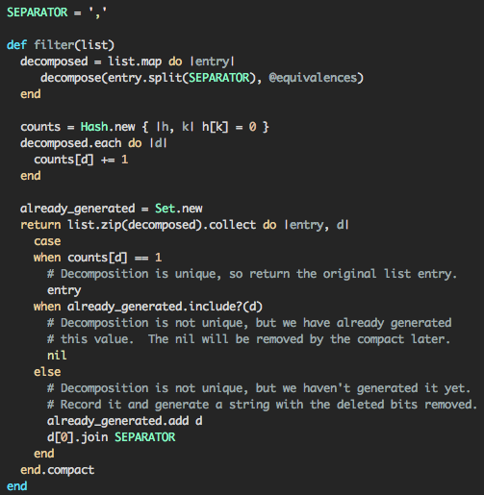
Internal changes
Invisible work
  Development practices
  Testing
  Packaging
  Deployment
  …
Notes:
In addition to user visible changes I have been working on the "invisible work" of speeding things up, cleaning up the HTML, helping Chris work on passing more information in from autotest, and so on.
Some of the work has been on myself, improving development processes so that I'm focussed on one thing at a time and making my best effort to have tests for new features so I can deliver releases confidently every few days (circumstances permitting).
The code has been packaged up in to Chef so that it can be repeatably and reliably deployed and rolled back.
There's still plenty of room for improvement, but let's move on to the development priorities I use to guide me.

Slide 27
Development priorities
Notes:
It shouldn't be a surprise that quality is what drives the development priorities.

Slide 28
Development priorities
Tool quality
  Mechanics of Maloo and its development
  Visibility into the tool
  Usability
Notes:
The quality of a tool is its fitness for purpose.
The development practices mentioned a few moments ago mean that I'm less likely to accidentally break something as I develop and deploy new code. Perhaps one day I'll be able to detect speed regressions too...
The value in Maloo is to give developers access to test results as quickly as possible, and apart from that to stay out of the way. Ideally Maloo should be "self service" so that developers can get on without waiting.
Lustre developers should be able to see if their results have been successfully uploaded into Maloo, and if they aren't in Maloo then the developer should be able to see why the upload failed or where the upload is queued.
They need visibility into the tool.
The tool should be usable, and that has several facets. I'd like to improve the response time, and I'd also like to make mode information available and make it easy for users to discover where stuff is - without having to ask.

Slide 29
Development priorities
Data quality
  Accurate
  Timely
  Accessible
Notes:
Maloo must accurately store the data from the test runs in a timey fashion so that developers can look at the results soon after a test run has completed.
The developers must be able to make use of the data. It has to be accessible.

Slide 30
New features
Notes:
Now I'm going to move on to a couple of features we plan to develop soon.

Slide 31
New features
Log file scanning
Automates a tedious task
Notes:
Currently Maloo just stores the log files, and we rely on test results being reported accurately to alert developers that something is wrong. We can scan the log files for interesting strings and flag the test sessions on the front page if something unusual is detected. This could take a user quickly to a page displaying the areas of the log files which were flagged.
This automation means developers can quickly be alerted to unexpected issues in Lustre or the test suite. People will still read the logs as necessary, this just helps speed things along.
(We could extend this to full text searching of the log files, but that's another feature.)
The next few slides show how it might work.

Slide 32
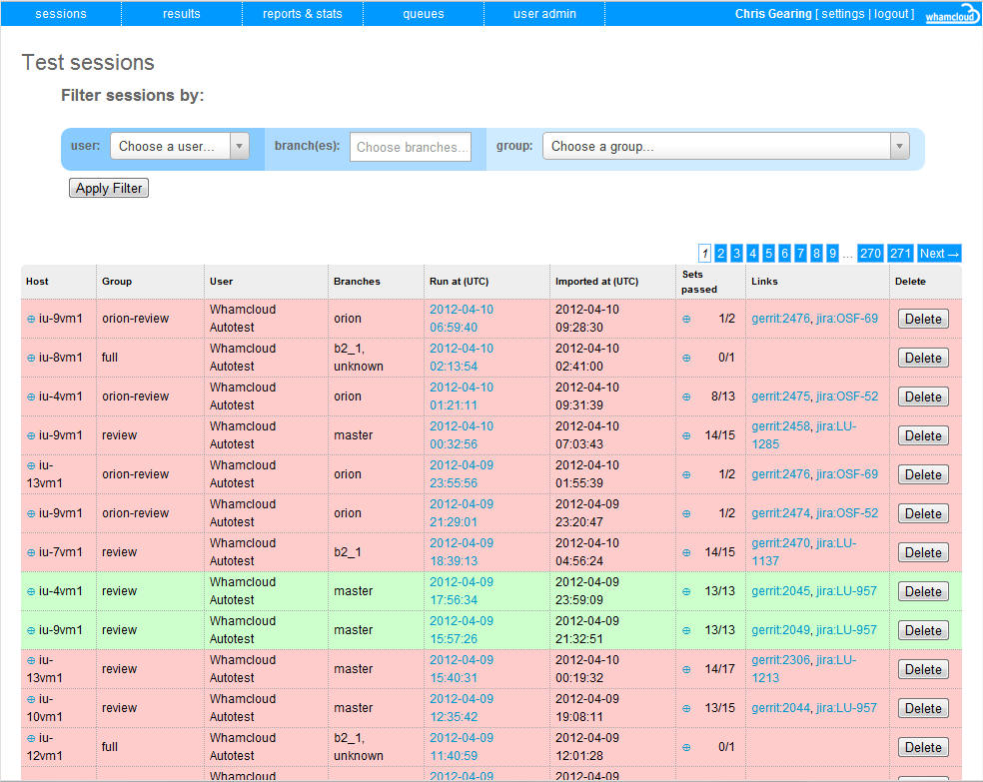

Maloo Footprints
Notes:
There will be some indicator, in these mock-ups it's a footprint, which indicate that a test session's logs are interesting.

Slide 33
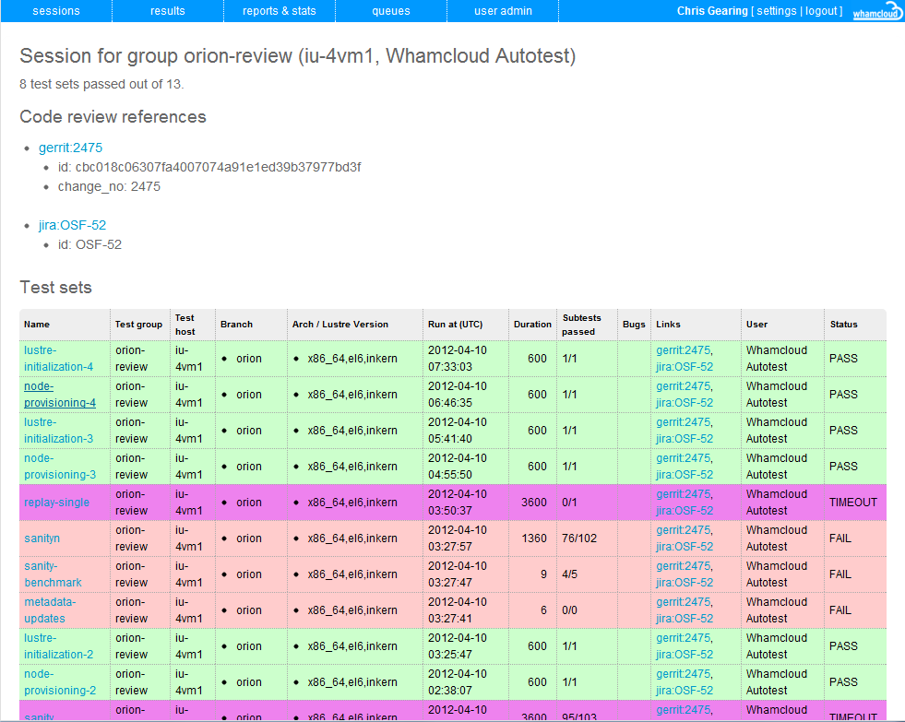
Maloo Footprints
Notes:
Clicking on the indicator will lead you to the tests with interesting logs.

Slide 34
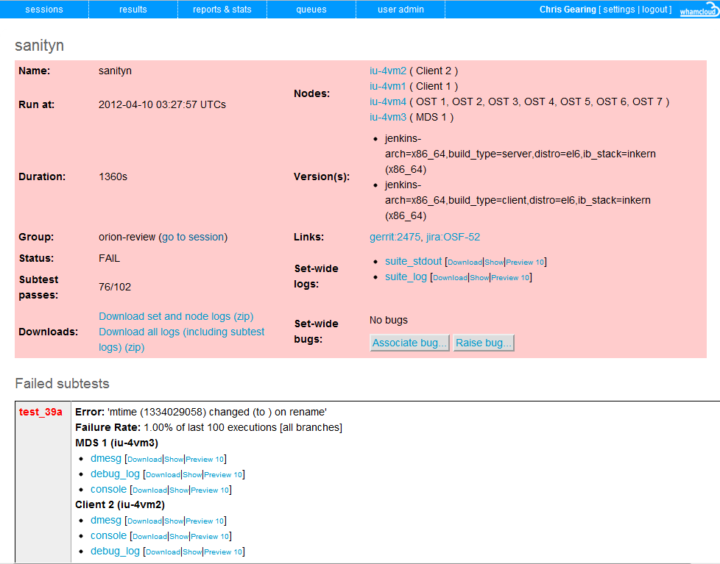

Maloo Footprints
Notes:
And we can drill down into that test to see which logs are interesting.

Slide 35
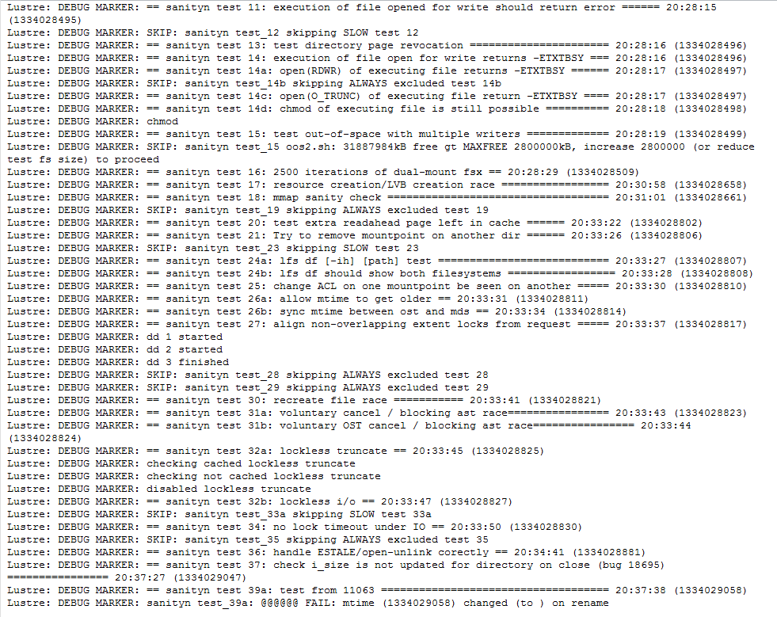
Maloo Footprints
Notes:
And pretty quickly end up at the line of interest.

Slide 36
New features
User profiles
One size needn’t fit all
Notes:
The next feature is user profiles, we make people sign up and log in, why not use that to their advantage?
Different people want to see different views of the data. Even when it's essentially the same data one person might want to see one set of columns in a particular order, and another person might be interested in other columns. Rather than crowd the display we can give each user preferences and let the users decide what they to see. We can also have preferences for which page to land on after signing in, filtering and sorting being remembered between visits etc.

Slide 37
Wrap up and questions
What was covered
Changes in Maloo since last year
Our development priorities
A couple of the planned changes
Notes:
That's all I was going to cover. We've looked at:
the changes which have been made in Maloo since last year
what my development priorities are
some of the things which might be coming out soon
If there are any comments or questions we can take them if time permits, or you can collar one of me or Chris when you see us.

Slide 38
Thank you very much

