Slide 1
Best Practices for Scalable Administration of Lustre
Blake Caldwell
National Center for Computation Sciences
April 25, 2012
LUG 2012 – Austin, TX

Slide 2
What’s different at scale?
What we expect:
  Overhead in administering more nodes
  More frequent failures and new failure modes
How we deal with them:
  Redundancy
  Automated monitoring and alerting
  Scalable administration tools
  Testing

Slide 3
Scale-out over time
Deployments get staged/split/repurposed and entirely new deployments come along
  Heterogeneous environment: hardware, software stacks, infrastructure, security policies, availability and performance requirements
NCCS now manages 11 production Lustre filesystems
  272 Lustre servers (198 for Widow)
  5 Infiniband fabrics with 1458 HCAs
    Different OFED stacks

Slide 4
Commonality of Best Practices: Consistency
Ideal – single shared OS image
  Capture differences within configuration management
Reality – different hardware, maintenance procedures and timelines prevents this
Choose flexible cluster management tools that support this abstraction
  May still need custom tools

Slide 5
Best Practice 1:
Common Image for Lustre Servers
GeDI (Generic Diskless Installer) for image creation and provisioning
  Images built from RPMs
  Combines read-only NFS mount with ramdisks
  Handles creation of host specific scripts that run before init
Benefits
  Manage image by chroot on management server
    Package management (yum) works
  Stateless: powerman –r for a clean slate
7 of our filesystems share the widow image

Slide 6
Best Practice 2:
Configuration Management
Configuration management continually enforces consistency within a cluster
Hierarchical structure for flexible shared configuration across clusters
Version control provides accountability, history, workgroup coordination

Slide 7
Best Practice 3:
Monitoring and Alerting
Failures scale too
  Need to be [made] aware of them
Monitoring infrastructure needs to be extensible
  Combination of Nagios, Splunk, SEC, scripts
Nagios customizations
  Hardware checks
    RAID controllers
    Nodes: OMSA
  Lustre health, OSTs mounted, LNET stats
  Network fabric
Notes:
We heavily use Nagios through custom plugins, Try to monitor everything, even if it just means we want to get an email and not get woken up for a problem.

Slide 8
Best Practice 3a: Notifications for Diagnostics
Alerting *should* be a first diagnostic step
Common first notifications of Lustre problems
  Lustre health check
  Multipath checks fail
  Server load high or checks timeout
  Users: “df hangs” or “a client won’t mount”
Look at where problems slipped by without notifications for where to improve monitoring

Slide 9
Best Practice 3b:
Monitor Storage Interconnect Health
Any marginally functioning component could be affecting Lustre, but be masked by redundancy
Need to address:
  Monitor physical layer errors
    Lost connectivity to nodes HCAs is usually obvious, Nagios checks to monitor link degradation
    Monitor switch uplinks as well!
    SymbolErrors make us nervous
  Monitor IB switches (spines/line cards/fans/power supplies) just like any other network device
    Custom Nagios plugins
  Topology verification

Slide 10
Best Practice 4:
Event Correlation
Event correlation from Lustre log messages is difficult
Splunk has SEC’s functionality, but can be interactive
Splunk alert examples:
  Storage array logs: remove transient warnings, known bugs, and then email log
  Storage array component failures (disk/power)
  OSS node reboots
  Lustre: read-only targets, symptoms of open bugs

Slide 11
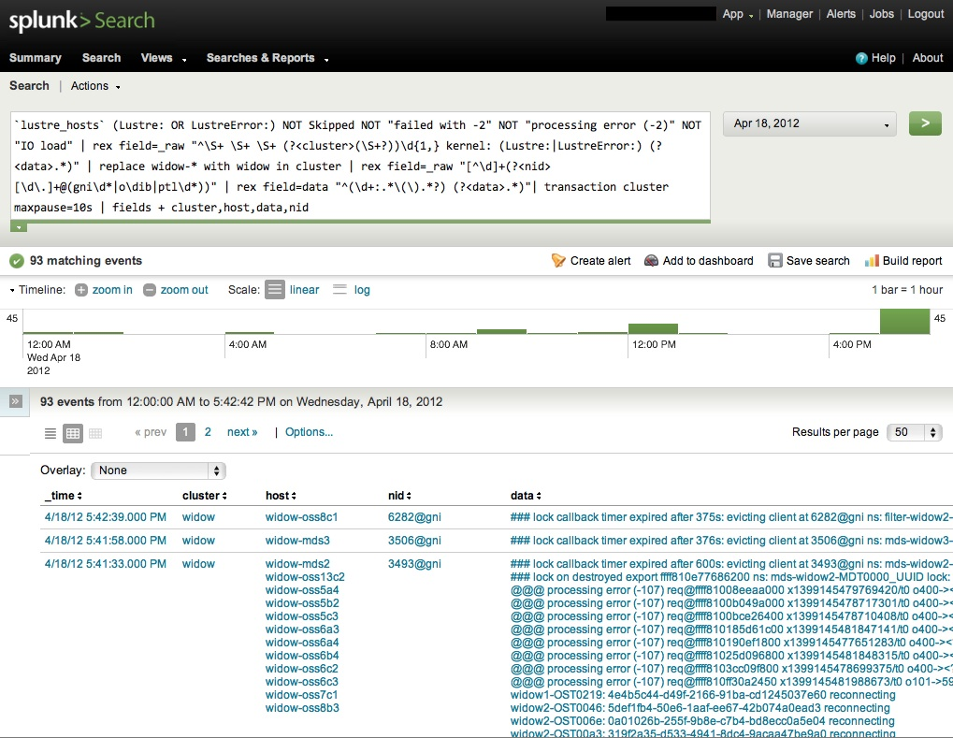

Slide 12
Best Practice 5:
Diagnostic Procedures
Collect from clients:
  Collect crash dumps (kdump)
  Lctl dk or debug daemon
  Timeouts
    lctl get_param –n ost.*.ost_io.timeouts
On management server
  Aggregate kernel/Lustre syslog messages
  IPMI console logging (conman)

Slide 13
Best Practice 6:
Workload Characterization
Need to determine if slow response time an issue or expected behavior
We have scripts that generate “MDS Trace Reports”
  Correlate Cray XK apstat information on jobs with rpctrace from /proc/sys/lnet/debug
  Latencies by RPC type (e.g. LDLM_ENQUEUE)
    Email if LDLM_ENQUEUE >= 1s
  Top RPC intensive jobs (correlated with job size)

Slide 14
Best Practice 7:
Fill in the gaps with custom tools
Implement purge policy
  We use ne2scan/genhit/purge from Nick Cardo at NERSC
Usage by user/project
  Lustre DU – pulls usage data from DB instead of metadata
Performance statistics
  DDNTool – polls DDN S2A 9900 performance and environmental stats via API, then stores in DB

Slide 15
Sum mary
We need consistency at scale
Administration best practices
  Common OS image
  Configuration management
  Monitoring and Alerting
  Event correlation
  Diagnostic procedures
  Workload characterization
  Custom tools

Slide 16
Resources
DDNTool/Lustre DU
  J. Hill, D. Leverman, S. Koch, D. Dillow. “Determining the health of Lustre filesystems at scale.” Cray User Group 2011, Fairbanks, AK. 1 May 2011. Conference Presentation.
  http://info.ornl.gov/sites/publications/files/Pub28556.pdf
MDS Trace Tool
  R. Miller, J. Hill, D. Dillow, R. Gunasekaran, D. Maxwell. “Monitoring tools for large scale systems.” Cray User Group 2010. Edinburgh. Scotland. 24 May 2011. Conference Proceedings.
GeDI
  http://sourceforge.net/projects/gedi-tools/
Splunk
  http://www.splunk.com
Linux@LLNL Software
  https://computing.llnl.gov/linux/downloads.html

