Slide 1



“Open Benchmark for Lustre” Initiative
November 14, 2011
1

Slide 2

What Is It
A Lustre performance benchmark for HPC community!
Called “Open Benchmark for Lustre” (OBL)
Initiated by NetApp Inc. and Whamcloud Inc.
HPC industry invited to participate in completing initiative and benchmark definitions, post SC11

Slide 3
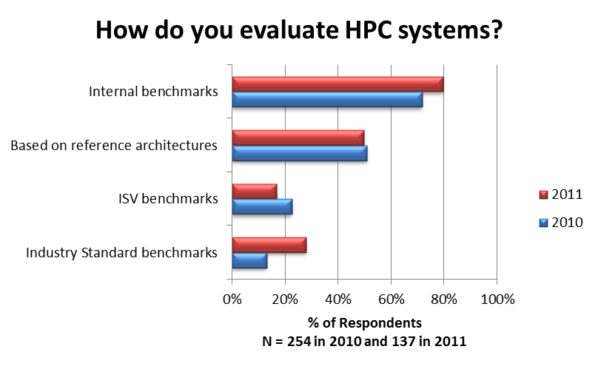
Why Is It Needed
Provide HPC community with industry standard Lustre benchmark data
More informed and quicker time to decision making
Credible, transparent, repeatable and objective

Slide 4
When and Where
Announced at SC11, Seattle, WA
At Whamcloud “Community Lustre Enhancements and Roadmap” Session at Exhibitor forum
  Tuesday November 15, 11:00 am, WSCC 613/614
  Open to All
NetApp / Whamcloud joint press release Nov 14, 2011
Brochures at Whamcloud Booth #2116, NetApp Booth 2605; www.whamcloud.com and www.netapp.com

Slide 5
Proposed Benchmarks
Various Lustre configurations
  High Availability, Non-high Availability
  Storage, OSS, Metadata
Primary reported result…keep it simple
  Aggregate read/write bandwidth (GB/s)
Secondary reported results…provides more depth
  Calculated ratios, such as bandwidth/U, power/U, $/TB
Disclosure details
  Components, configuration, settings, version, etc.
Measurement process
  Methodology, procedure, tools, etc.
Posted on public website

Slide 6
Call to Action, Post SC11
Industry collaborates to finalize
  Initial benchmark definitions and procedures
  Logistics for reviewing and publishing results
  Collateral and logo usage
  Funding
Publish initial results prior to International Supercomputing Conference (ISC), June 2012
Select a neutral, going-forward steward for the Open Benchmark for Lustre initiative
  Announce at International Supercomputing Show, June 2012
  Whamcloud and NetApp will steward until then
Contact: info@openbenchmarkforlustre.org to participate

Slide 7
Proposed Work Schedule
Dec 8 - Webinar hosted by Whamcloud and Netapp, 8:00am PDT. Invitations will be sent Monday Nov 28th.
  Purpose to review the proposed Open Benchmark for Lustre initiative
  Establish this as the date & time for the first of every other week meeting. Next meeting Dec 22.
January 31 - Benchmark definition and Review Processes completion date.
  Definition of the benchmark completed
  Liaisons from each company identified
  Structure of Review process defined
  Logo usage and funding defined
  Reviews to be done in a timely manor by the designated stewards
April 23-25 - Face to face meeting at LUG 2012
  Hyatt Regency, Austin Texas
June 17-21 - ISC 2012 Hamburg Germany
  Announce going forward steward for Open Benchmark for Lustre initiative

Slide 8
Thank You

