Slide 1
Lustre Automation Challenges
John Spray
Whamcloud, Inc.
0.4

Slide 2
Introduction
Chroma is one of several management platforms being developed for Lustre.
These platforms are quite different, but all share the same interface to the underlying filesystem.
This presentation suggests some areas where the interface that Lustre provides might be improved.

Slide 3
Caveats
This isn’t a criticism of the existing implementation, it’s about how requirements from automation systems might lead to extensions and improvements.
Items discussed here may be cleanliness/robustness rather than functionality.
No degradation of the manual administration experience -- look for the best of both worlds.

Slide 4
Topics
Target operations
Managing configuration data
The MGS in a managed environment

Slide 5
Target detection for monitoring
There is no interface for learning the persistent configuration parameters from an MGS -- we have to use debugfs and llog_reader.
Because filesystem/target names are non-unique, we have to resolve the MGS using NIDs: this would be a lot easier if the top level namespace (the MGS) has a UUID that was propagated. It would also allow better interoperability as there would be a unique MGS-FS-Target name.

Slide 6
Target initialization
mkfs.lustre is not idempotent unless using the --reformat argument.
  A separate entry point for simply doing the formatted-ness check would make automation easier
  Or just don’t object to formatting something if it hasn’t been registered yet
Target indices may be set at format time, but are validated at registration time
  Ideally, we would talk to the MGS when creating a filesystem, ask it to assign target indices, and include those during formatting.
  As it is, we have to replicate the generating and checking of IDs

Slide 7
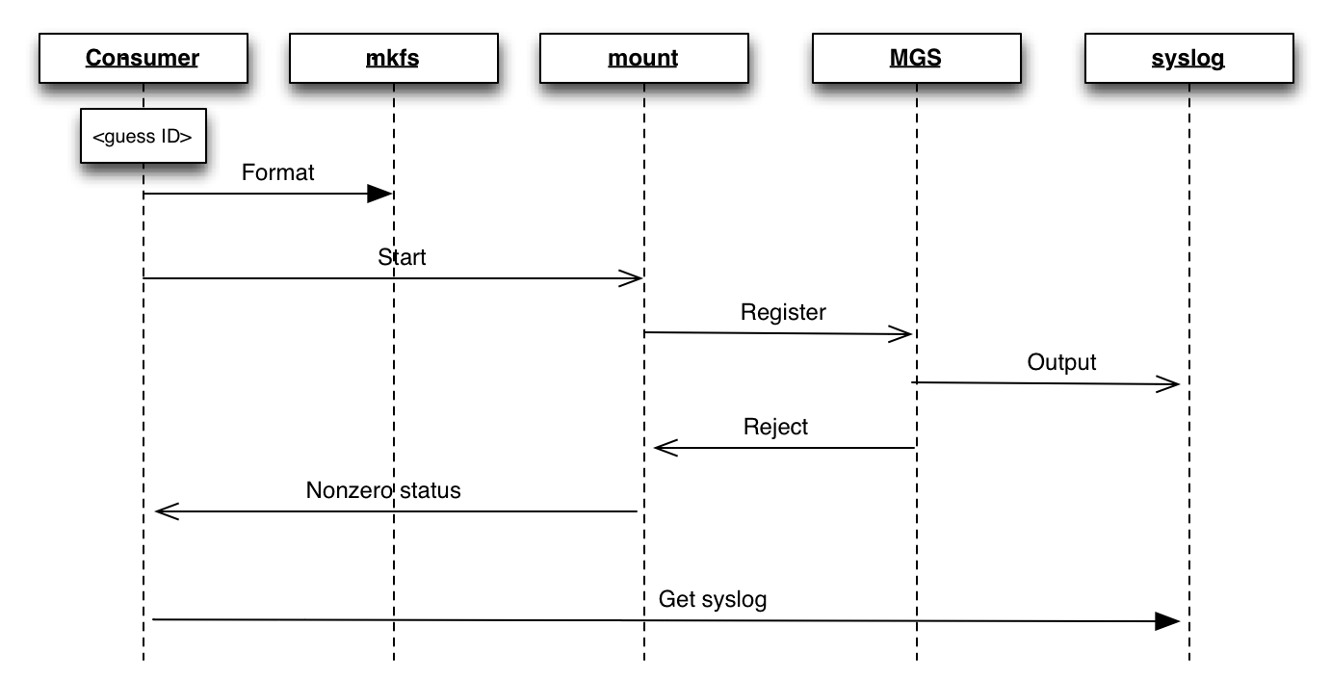
Current registration

Slide 8
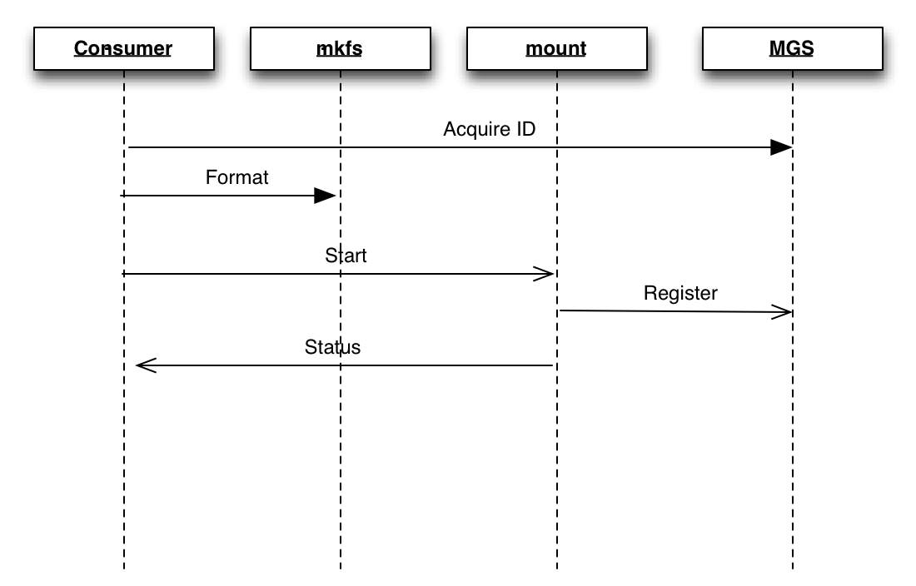
Simplified registration

Slide 9
Target operations in general
Blocking calls to mount/mkfs make it inconvenient to give the user feedback:
  Simple things like cancelling an ongoing format become hard.
  Querying the status of an ongoing mount has to be done out of band.
Linux processes aren’t ideally suited for tracking progress in an unreliable environment.
Ideally, operations could be started asynchronously from userspace, and then monitored/cancelled in a generic way.
This interface might be overkill for starting and stopping targets, but could be interesting for future functionality too (start and monitor an OST evacuation?)

Slide 10
Managing tunables
Long-standing pain point of administration, turns out to be almost as problematic for automation
Management layer must do all its own validation and have a complete knowledge of allowable conf_param arguments.
Simple things like reading back a value that we just set are awkward, may have to read it on a different server by a different name.
Similar lack of in-band validation that we saw in target registration.

Slide 11
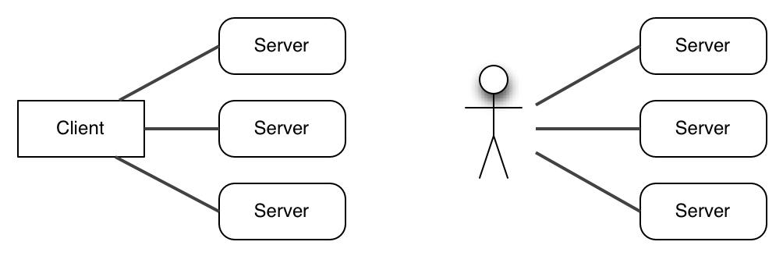
I/O path
- Decoupling is good
Control path
- Decoupling is bad

Slide 12
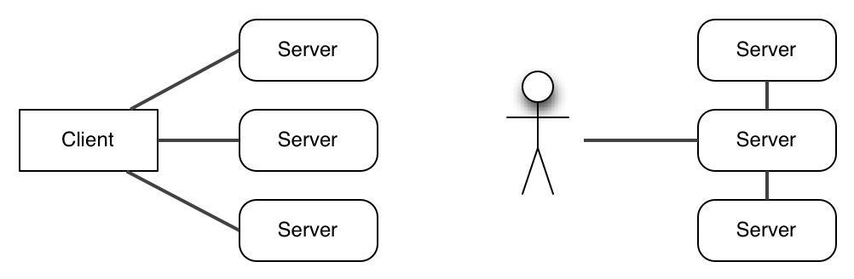
The I/O path remains parallel, while…
A good control path provides a single point of truth

Slide 13
Improving tunables
Harmonize naming (set_param vs conf_param)
Validate tunables at the point of assignment, rather than waiting until target mount to find an error (requires MGS to have more knowledge of targets versions/capabilities)
Allow reading back tunables from the MGS
Reconcile dual path of access (MGS vs. local /proc/) -- perhaps even always set these centrally, including temporary values?

Slide 14
The role of the MGS
In a managed environment, everything we store in the MGS is something we already know in our management database (pools, tunables etc)
The configuration aspect of the MGS becomes a (slightly awkward) proxy.
We recommend that the pools definitions (and conf_param settings) be executed via a script, so they can be reproduced easily after a writeconf is performed.
- Lustre Operations Manual

Slide 15
MGS: More flexible configuration
Remove the requirement for a dedicated block device:
  Consequentially remove the motivation for having multiple filesystems use the same MGS
Remove the requirement for one NID per MGS:
  Allow MGS services to be active/active distributed among servers with access to the configuration storage.
Create an interface for the MGS to access configuration data directly from the automation layer.

Slide 16
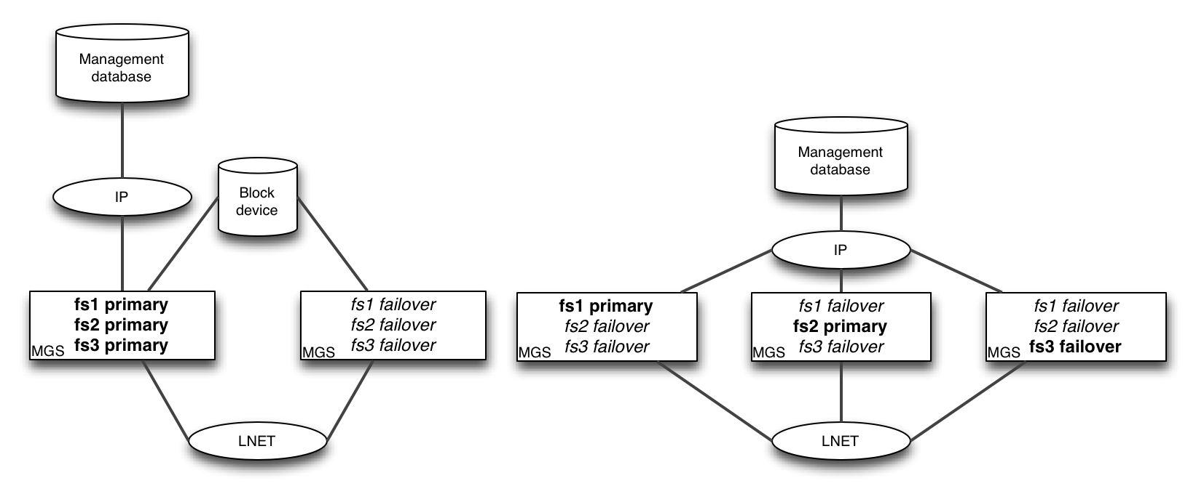
MGS: More flexible configuration
Present day
More flexible configuration

Slide 17
MGS: Kernel vs. userspace
Of course, there are some good reasons the MGS lives in the kernel:
  Share code with the rest of Lustre (which *does* have a good excuse to be in kernel space)
  Use KLNDs
But what if we only put as much in kernel space as really needed to be there?
  A minimal pass-through MGS service in kernel space (something like an LNET proxy)
  Run the real logic to userspace
  Pluggable backing stores: by default use a file store, or plug your automation layer straight into it. Store interface would allow automation layer to receive notifications on configuration/state changes

Slide 18
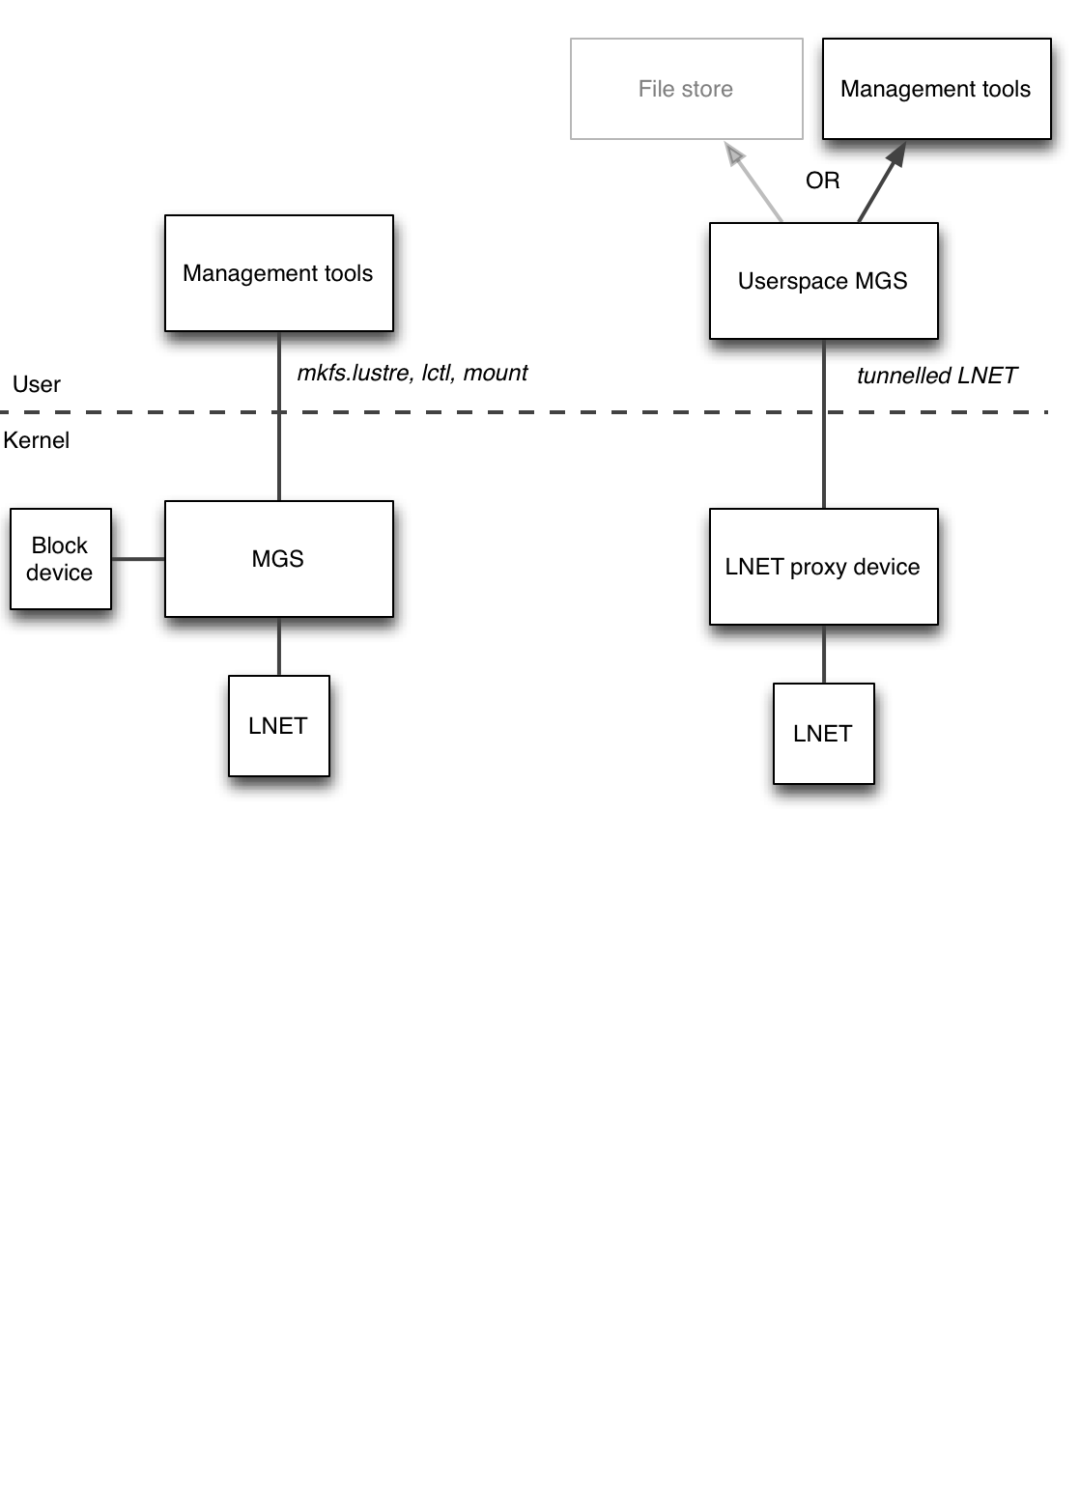
Hypothetical userspace MGS

Slide 19
Thank You
John Spray
  Senior Software Engineer
  Whamcloud, Inc.

