Slide 1
How to Tune Your Wide Area File System for a 100 Gbps Network
Experiences from the SCinet Research Sandbox
Scott Michael
LUG2012
April 24,2012

Slide 2
Talk Roadmap
Background: IU’s Lustre-WAN efforts to date
Lustre-WAN at 100 Gbps: SC11 SCinet Research Sandbox entry
LNET measurements: Important tunables

Slide 3
Wide Area Lustre in Production at IU

Slide 4
Lustre-WAN at IU
We have had and currently have several remote client production mounts with a range of bandwidths and latencies
  Clients connected at 1 Gbit and 10 Gbit
  Clients connected across various regional, national, and international networks
  Latencies ranging from a few milliseconds to 120 milliseconds

Slide 5
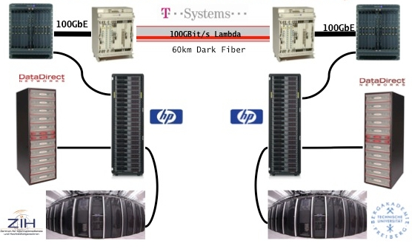
100 Gbits Over Low Latency
Dresden to Freiberg − 60 km − 0.72 ms
Throughput 10.8 GB/s − 86% efficiency

Slide 6
100 Gbits Over a Bit More Latency
Indiana University submitted an entry to the SC11 SCinet Research Sandbox program to demonstrate cross-country 100 Gbit/s Lustre performance
The demonstration included network benchmarks, LNET testing, file system benchmarks, and a suite of real-world scientific workflows

Slide 7
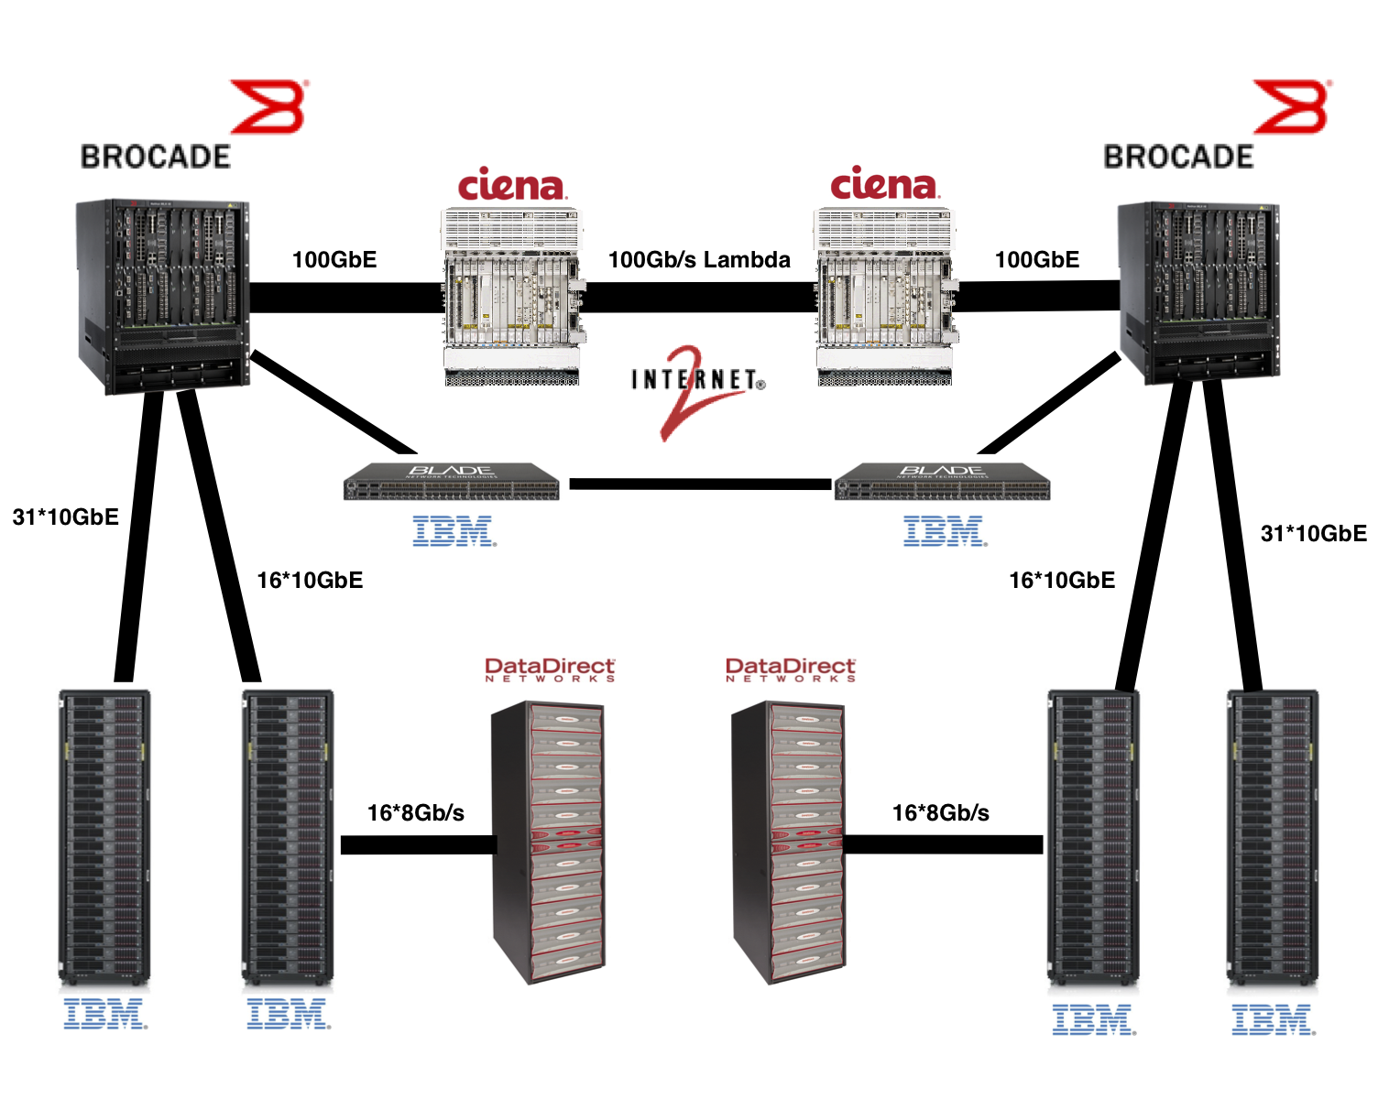
SCinet Research Sandbox Setup
Seattle to Indianapolis − 3,500 km − 50.5 ms

Slide 8
SCinet Research Sandbox Outcome
 | Measurement | Efficiency
Latency | 50.5 ms | −
TCP iperf | 96 Gbit/s | 96%
IOR | 6.5 GB/s | 52%
Applications | 6.2 GB/s | 50%
Relatively small cluster
20 hours of test, troubleshoot, and demo time

Slide 9
Workflow Suite
Enzo – astronomical adaptive mesh code
Vampir – parallel tracing code and debugger
Heat3d – heat diffusion code
ODI – astronomical image reduction pipeline
NCGAS – genomics codes
OLAM – climate code
CMES – Computational Model for Electroencephalography responses in Schizophrenia - computational neuroscience
Gromacs – molecular dynamics code

Slide 10
More RPCs Are Needed
For high latency links max_rpcs_in_flight has to be increased from the default of 8
One can show the max throughput for a given connection is:
or to maximize a given link…

Slide 11
What We Learned About credits
Initial LNET testing for a single client/server showed we were unable to achieve theoretical throughput
Throughput leveled off past RPCs of 8
This was due to the default settings of credits and peer_credits

Slide 12
What We Learned About credits
Single client/server LNET performance was 1092 MB/s − 89% efficiency
We saw somewhat improved performance with the entire system and increased credits, but less than expected

Slide 13
Summary and Implications
Cross-country 100 Gbit networks are here or coming soon
Lustre-WAN is a useful tool for empowering geographically distributed scientific workflows
Centers that deploy Lustre-WAN systems should consider the impact of RPCs and credits
Multiple wide area/local client endpoints require some planning when setting tunables

Slide 14
Thank You for Your Attention
Questions?
Scott Michael
Indiana University
scamicha@iu.edu
Look for the LNET paper at DIDC2012 in conjunction with HPDC
A Study of Lustre Networking Over a 100 Gigabit Wide Area Network with 50 milliseconds of Latency, DIDC ‘12

