Slide 2
Leveraging Lustre to address
I/O Challenges of Exascale
Lustre User Group
Austin, Tx
April, 2012
Eric Barton
  CTO
  Whamcloud, Inc.
  eeb@whamcloud.com

Slide 3
Agenda
Forces at work in exascale I/O
  Technology drivers
  I/O requirements
  Software engineering issues
Proposed exascale I/O model
  Filesystem
  Application I/O
  Components

Slide 4
Exascale I/O technology drivers
 | 2012 | 2020
Nodes | 10-100K | 100K-1M
Threads/node | ~10 | ~1000
Total concurrency | 100K-1M | 100M-1B
Memory | 1-4PB | 30-60PB
FS Size | 10-100PB | 600-3000PB
MTTI | 1-5 Days | 6 Hours
Memory Dump | < 2000s | < 300s
Peak I/O BW | 1-2TB/s | 100-200TB/s
Sustained I/O BW | 10-200GB/s | 20TB/s
Object create | 100K/s | 100M/s

Slide 5
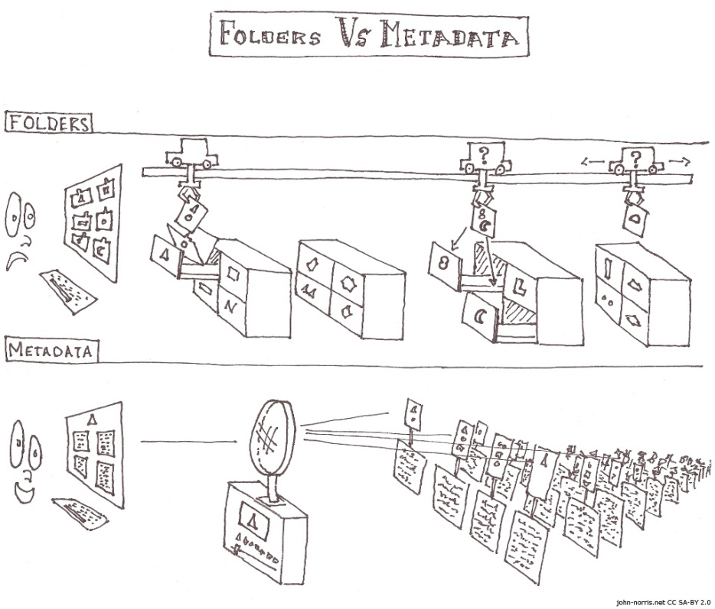
Exascale I/O technology drivers
(Meta)data explosion
  Many billions of entities
    Mesh elements
    Graph nodes
    Timesteps
  Complex relationships
  UQ ensemble runs
OODB
  Read/Write -> Instantiate/Persist
  Index / Search
    Where’s the 100 year wave
  Data provenance + quality
Storage Management
  Migration / Archive

Slide 6
Exascale I/O Architecture
Exascale Machine
Shared Storage
Site
Storage
Network
Exascale
Network
I/O
Nodes
Disk
Burst buffer
NVRAM
Storage
Servers
Metadata
NVRAM
Compute
Nodes

Slide 7
Exascale I/O requirements
Concurrency
  Death by 1,000M cuts
    Scattered un-aligned variable size data structures
    Asynchronous I/O
  I/O Staging
    Aggregate ~100 compute nodes x ~100-1000 threads
    Burst buffer / pre-staging
    “Laminar” data flow to global file system
      Object-per-staging process
Search & Analysis
  Multiple indexes
  Ad-hoc index creation
  Pre-stage data for analysis
    Subset determined by ad-hoc query

Slide 8
Exascale I/O requirements
(Meta)data consistency + integrity
  Metadata at one level is data in the level below
  Foundational component of system resilience
  Required end-to-end
Balanced recovery strategies
  Transactional models
    Fast cleanup up failure
    Filesystem always available
    Filesystem always exists in a defined state
  Scrubbing
    Repair / resource recovery that may take days-weeks

Slide 9
Exascale I/O requirements
Global v. local storage
  Global looks like a filesystem
  Local looks like
    Cache / storage tier
      How transparent?
    Something more specific?
Automated / policy / scheduler driven migration
  Pre-staging from global F/S
  Post-writeback to global F/S
Fault isolation
  Massive I/O node failure cannot affect shared global F/S
Performance isolation
  I/O staging nodes allocated per job
  Qos requirements for shared global F/S

Slide 10
Software engineering
Stabilization effort required non-trivial
  Expensive/scarce scale development and test resources
Build on existing components when possible
  LNET (network abstraction), OSD API (backend storage abstraction)
Implement new subsystems when required
  Distributed Application Object Storage (DAOS)
Clean stack
  Common base features in lower layers
  Application-domain-specific features in higher layers
  APIs that enable concurrent development

Slide 11
Exascale shared filesystem
/projects
/Legacy
/HPC
/BigData
Conventional namespace
  Works at human scale
  Administration
    Security & accounting
  Legacy data and applications
DAOS Containers
  Work at exascale
  Embedded in conventional namespace
  Scalable storage objects
  App/middleware determined object namespace
Storage pools
  Quota
  Streaming v. IOPS
Posix striped file
a
b
c
a
b
c
a
b
c
a
Simulation data
OODB metadata
OODB metadata
OODB metadata
OODB metadata
OODB metadata
data
data
data
data
data
data
data
data
data
data
data
data
data
data
data
MapReduce data
Blocksequence
data
data
data
data
data
data
data
data
data

Slide 12
I/O stack
Userspace
Application
Query
Tools
Middleware
DAOS Containers
  Application data and metadata
  Object resilience
    N-way mirrors / RAID6
  Data management
    Migration over pools / between containers
  10s of billions of objects distributed over thousands of OSSs
    Share-nothing create/destroy, read/write
    Millions of application threads
  ACID transactions on objects and containers
    Defined state on any/all combinations of failures
    No scanning on recovery
DAOS
Kernel
Storage

Slide 13
I/O stack
Userspace
Application
Query
Tools
Middleware
Userspace
  Easier development and debug
  Low latency / OS bypass
Middleware
  Domain-specific API style
    Collective / independent
    Transaction model
    OODB, Hadoop, HDF5, Posix…
  I/O staging / burst buffers
Applications and tools
  Backup and restore
  Query, search and analysis
  Data browsers, visualisers and editors
  General purpose or application specific according to target APIs
DAOS
Kernel
Storage

Slide 14
Thank You
Eric Barton
  CTO
  Whamcloud, Inc.
  eeb@whamcloud.com

